Slide 1

Smart Water Billing System
Guide Name: Prof.R.D.Uttarkar
Presented By,
1.Shamli Salunke
2.Aishwarya Indi
3.Arti Koli

Slide 2
Contents
Previous system
Introduction to smart water billing system
Need of smart water billing system
Technology Used
User requirements
ER diagram
Advantages and disadvantages
Conclusion

Slide 3
Existing System
Based on just reading the units from water meter after every specific time period and find out whether there is leakage or not as per units of water consumed.
If system finds that there is difference between these two measurements then system will show alert message to end user about leakage.
The system handle the payments of water bill.

Slide 4
Introduction
Water Billing System is an automated system indirectly based on paying water bills but by consuming required amount of water by having control on water usage.
This is made in Java Script and MySQL server for the database.
This system responsible for calculating water bill in every month, generating report of water meter usage and sending notification to the end user about total units consumed in every month.
A penalty, discount and applicable charges will then be added in water bill as per meter types and its usage.

Slide 5
Need Of Using Smart Water Billing System
Lack of water regulation
Exceed in water bill amount than available budget
Unawareness about discounts, penalties where they are applicable and about its charges
Unawareness about how water bill is calculated
Helps to consume only required quantity of water
Helps to detect problem related to water meter connection like leakage, water meter failure etc.

Slide 6
Technology Used
Software and hardware requirement :
Desktop machine
NetBeans IDE 7.0.1
MySQL server
Raspberry pi circuit for reading water meter reading
Methodology used :
Agile Methodology

Slide 7
User Requirements
Should able to generate report
Generate bill
Receive notification
Able to change own as well as meter connection profile
Able to view current rate per unit along with all possible charges and their rates.
Able to know discount is applicable in which condition
Able to view due amount and its due charge in next bill amount if due date is gone and bill is not pay
Able to provide feedback

Slide 8
Modules Used
Customer
Meter Connection
Bill
Rate Per Unit
Payment Details

Slide 9
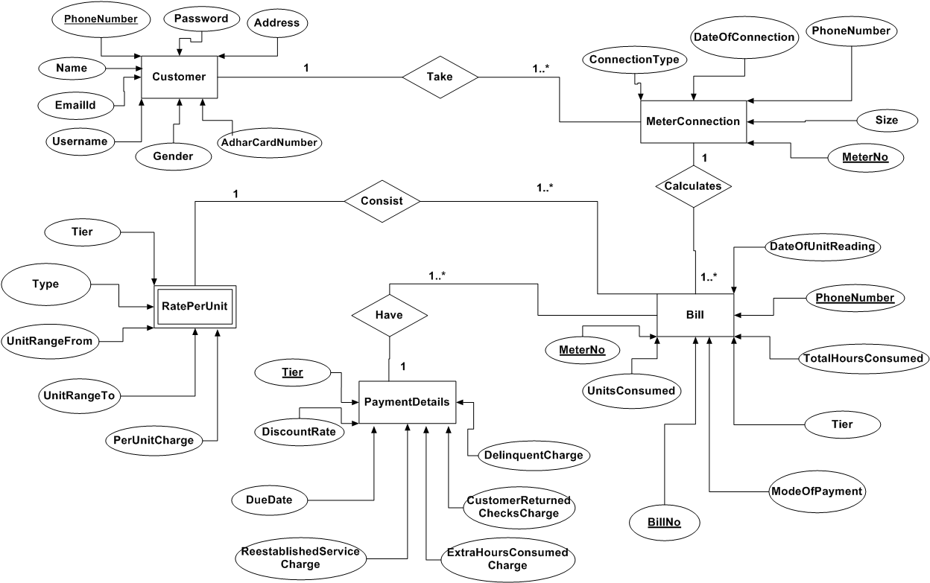
ER Diagram

Slide 10
Advantages
Faster and more efficient meter reading
Greater billing accuracy
Ability to remotely monitor resource use
Notification of consumed water meter units to the respective user
Improved water conservation and efficiency
Save water and its cost
Strategic Prioritization and allocation of capital expenditures
Streamlined network operations and maintenance
Streamlined water quantity monitoring

Slide 11
Disadvantages
Must require internet connection
User only view payment and its details not able to pay bill online with this system
Extra cost of smart water meter has to be paid with bill amount

Slide 12
Conclusion
Smart water metering refers to a system that measures water consumption or abstraction and communicates that information in an automated fashion for monitoring and billing purposes. This will reduce the extra consumption of water by limiting from wastage of water.
Now days many of smart cities are trying to implement this Smart water meter for better water usage and for less money.

Slide 13
SAVE LIFE……
SAVE WATER……

Slide 14
THANK YOU…

